Slide 1
Machine Learning CS229/STATS229
Instructors: Moses Charikar, Tengyu Ma, and Chris Re
Hope everyone stays safe and healthy in these difficult times!

Slide 2
1. Administrivia cs229.stanford.edu (you may need to refresh to see the latest version) 2. Topics Covered in This Course

Slide 3
Differences From Previous Quarters
Everything will be online --- lectures, Friday and discussion sections, office hours, discussions between students
We strongly encourage you to study with others students
Technology: Zoom, Slack, …
Enrollments increased by 2X in the last two weeks; Overloaded CAs
Course project is optional
Homework can be submitted in pairs
Take-home exams

Slide 4

Pre-requisite
Probability (CS109 or STAT 116)
distribution, random variable, expectation, conditional probability, variance, density
Linear algebra (Math 104, Math 113, or CS205)
matrix multiplication
eigenvector
Basic programming (in Python)
Will be reviewed in Friday sections (recorded)
This is a mathematically intense course.
But that’s why it’s exciting and rewarding!
Notes:
Mention that we will use whiteboard for the rest of the course

Slide 5
Honor Code
Do’s
form study groups (with arbitrary number of people); discuss and work on homework problems in groups
write down the solutions independently
write down the names of people with whom you’ve discussed the homework
read the longer description on the course website
Don’ts
copy, refer to, or look at any official or unofficial previous years’ solutions in preparing the answers

Slide 6
Honor Code for Submission In Pairs
Students submitting in a pair act as one unit
may share resources (such as notes) with each other and write the solutions together
Both of the two students should fully understand all the answers in their submission
Each student in the pair must understand the solution well enough in order to reconstruct it by him/herself

Slide 7
Course Project (Optional)
We encourage you to form a group of 1-3 people
same criterion for 1-3 people
More information and previous course projects can be found on course website
List of potential topics
Athletics & Sensing Devices Audio & Music Computer Vision Finance & Commerce General Machine Learning | Life Sciences Natural Language Physical Sciences Theory Reinforcement Learning Covid-19

Slide 8
Other Information on Course Website cs229.stanford.edu
Piazza:
All announcements and questions (unless you would only reach out to a subset of course staff)
For logistical questions, please take a look at course FAQ first
Finding study groups friends
If you enrolled in the class but do not have access to Piazza, it should come within a day. If it has been more than that, send Kush an email
Slack workspace
Videos on canvas
Course calendar: office hours and deadlines
Gradescope
Late days policy
FAQ on the course website

Slide 9


Slide 10
1. Administrivia cs229.stanford.edu 2. Topics Covered in This Course

Slide 11
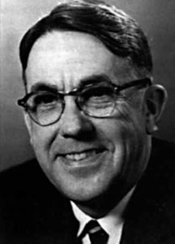

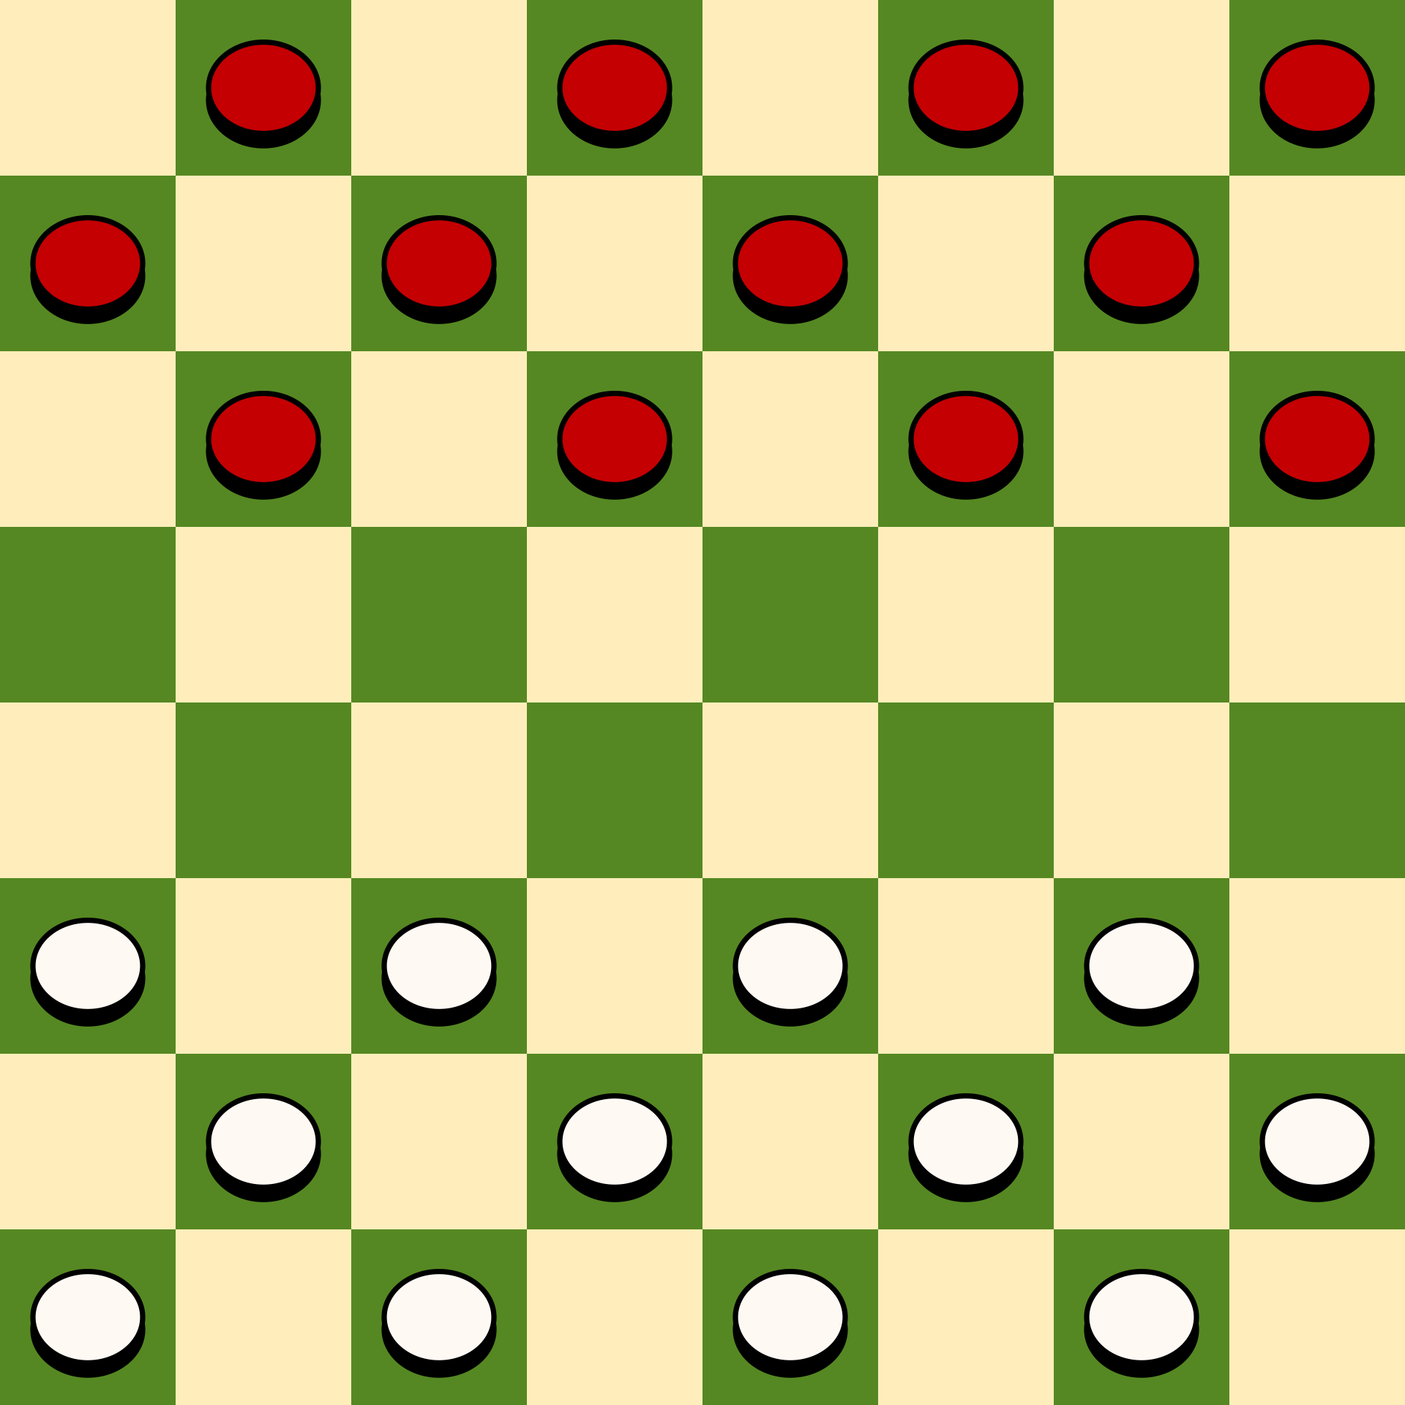
Definition of Machine Learning
Arthur Samuel (1959): Machine Learning is the field of study that gives the computer the ability to learn without being explicitly programmed.
Photos from Wikipedia

Slide 12
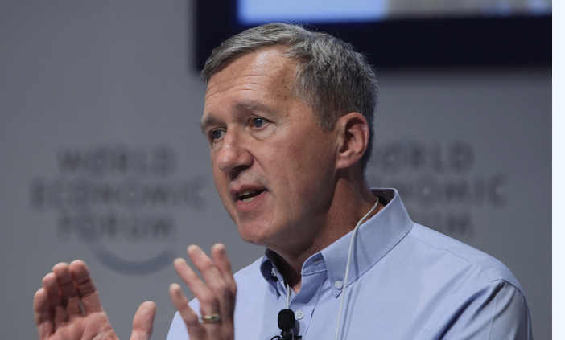
Definition of Machine Learning
Tom Mitchell (1998): a computer program is said to learn from experience E with respect to some class of tasks T and performance measure P, if its performance at tasks in T, as measured by P, improves with experience E.
Experience (data): games played by the program (with itself)
Performance measure: winning rate
Image from Tom Mitchell’s homepage

Slide 13
Taxonomy of Machine Learning (A Simplistic View Based on Tasks)
Supervised
Learning
Unsupervised
Learning
Reinforcement
Learning

Slide 14
Taxonomy of Machine Learning (A Simplistic View Based on Tasks)
Supervised
Learning
Unsupervised
Learning
Reinforcement
Learning
can also be viewed as tools/methods

Slide 15
Supervised Learning

Slide 16
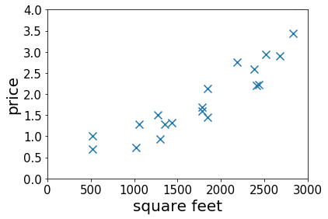

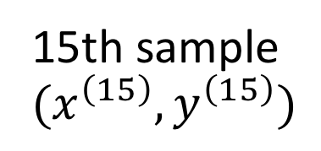
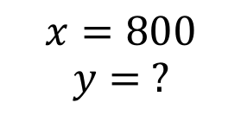
Housing Price Prediction
Given: a dataset that contains $n$ samples
$\left(x^{\left(1\right)},y^{\left(1\right)}\right), …(x^{\left(n\right)},y^{\left(n\right)})$
Task: if a residence has $x$ square feet, predict its price?
15th sample $(x^{\left(15\right)},y^{\left(15\right)})$
$$x=800$$
$$y= ?$$
Notes:
Mention the dataset is the experience

Slide 17
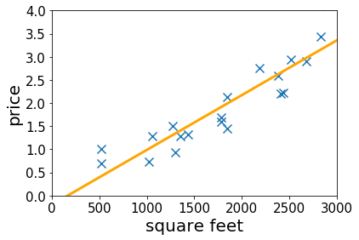
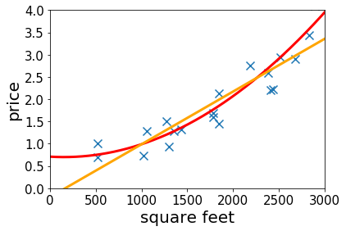
Housing Price Prediction
Given: a dataset that contains $n$ samples
$\left(x^{\left(1\right)},y^{\left(1\right)}\right), …(x^{\left(n\right)},y^{\left(n\right)})$
Task: if a residence has $x$ square feet, predict its price?
$$x=800$$
$$y= ?$$
Lecture 2&3: fitting linear/qaudratic functions to the dataset
Notes:
Mention the dataset is the experience

Slide 18
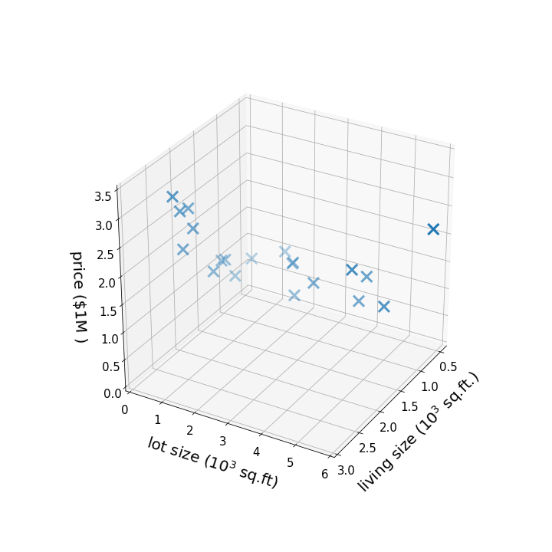


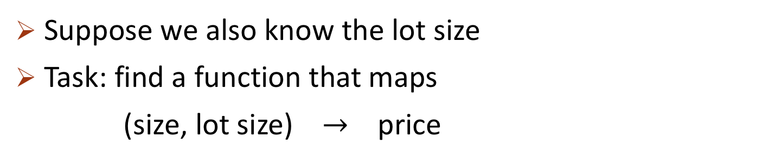
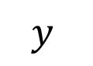
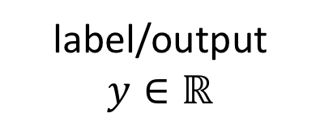
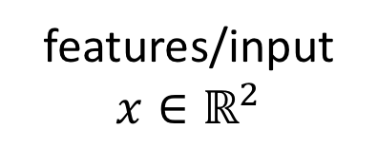
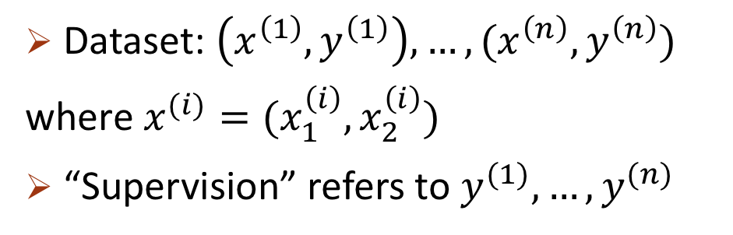
More Features
Suppose we also know the lot size
Task: find a function that maps
(size, lot size) $→$ price
features/input
$$x∈ℝ^{2}$$
label/output
$$y∈ℝ$$
$$y$$
Dataset: $\left(x^{\left(1\right)},y^{\left(1\right)}\right), …,(x^{\left(n\right)},y^{\left(n\right)})$
where $x^{(i)}=(x_{1}^{\left(i\right)},x_{2}^{\left(i\right)})$
“Supervision” refers to $y^{(1)},…, y^{(n)}$
$$x_{2}$$
$$x_{1}$$

Slide 19
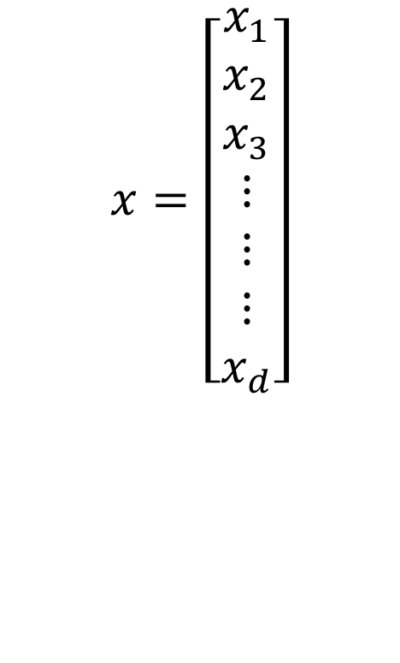



High-dimensional Features
$x∈ℝ^{d}$ for large $d$
E.g.,
--- living size
--- lot size
--- # floors
--- condition
--- zip code
$$⋮$$
$$x=\left[\begin{aligned}x_{1} \\ x_{2} \\ x_{3} \\ ⋮ \\ ⋮ \\ ⋮ \\ x_{d}\end{aligned}\right]$$
--- price
$$y$$
Lecture 6-7: infinite dimensional features
Lecture 10-11: select features based on the data

Slide 20
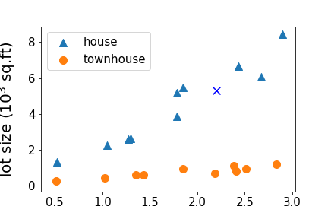
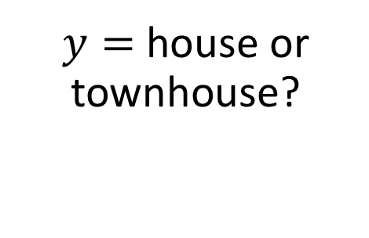
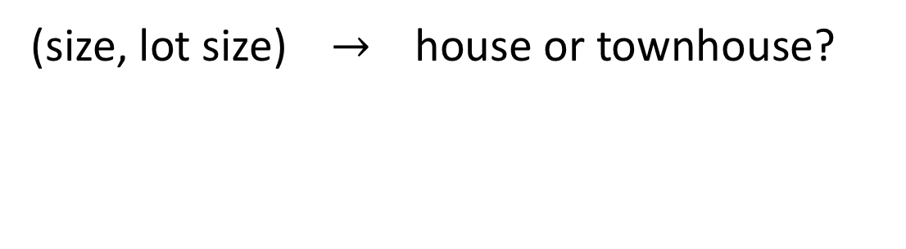

Regression vs Classification
regression: if $y∈ℝ$ is a continuous variable
e.g., price prediction
classification: the label is a discrete variable
e.g., the task of predicting the types of residence
(size, lot size) $→$ house or townhouse?
$y=$ house or townhouse?
Lecture 3&4: classification
Notes:
House vs townhouse

Slide 21
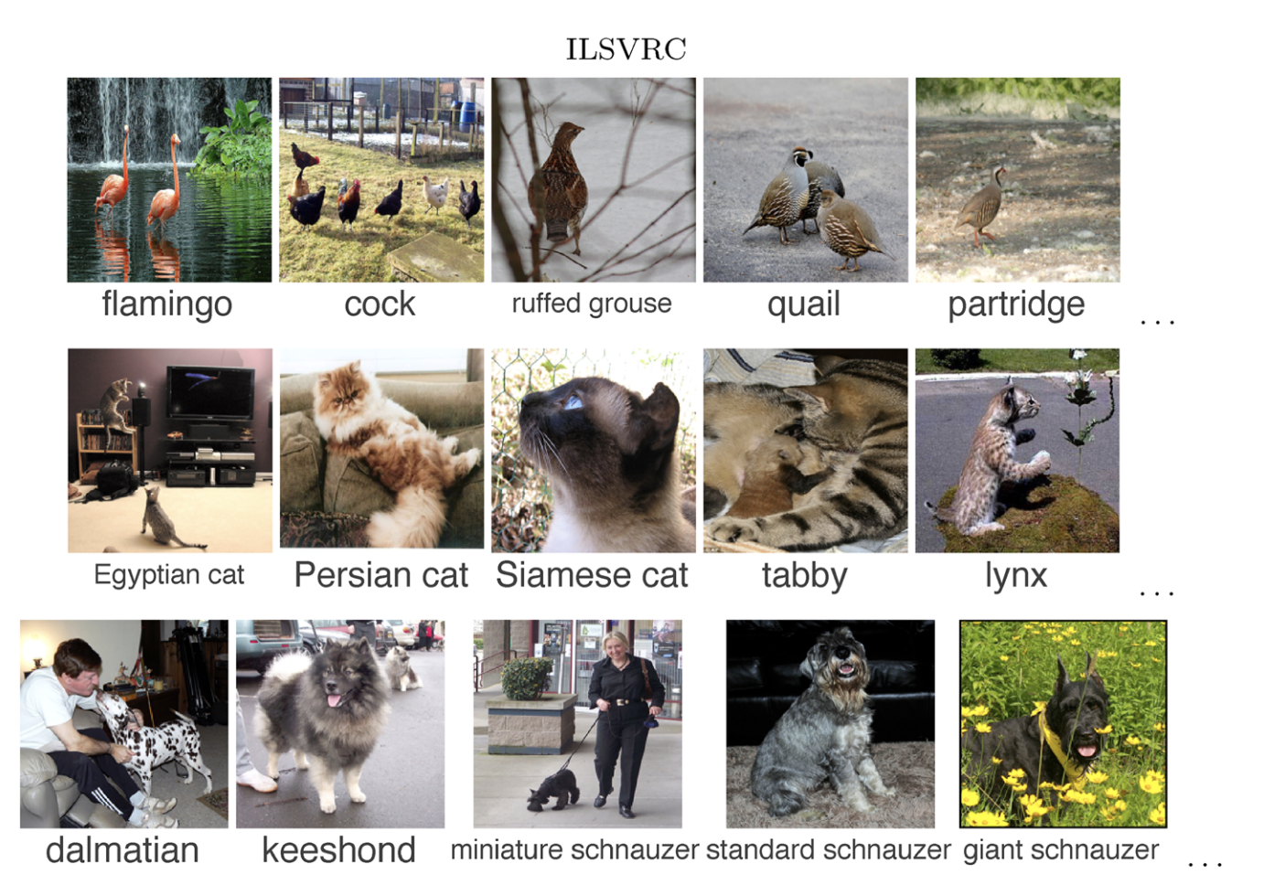

Supervised Learning in Computer Vision
Image Classification
$x=$ raw pixels of the image, $y=$ the main object
ImageNet Large Scale Visual Recognition Challenge. Russakovsky et al.’2015

Slide 22
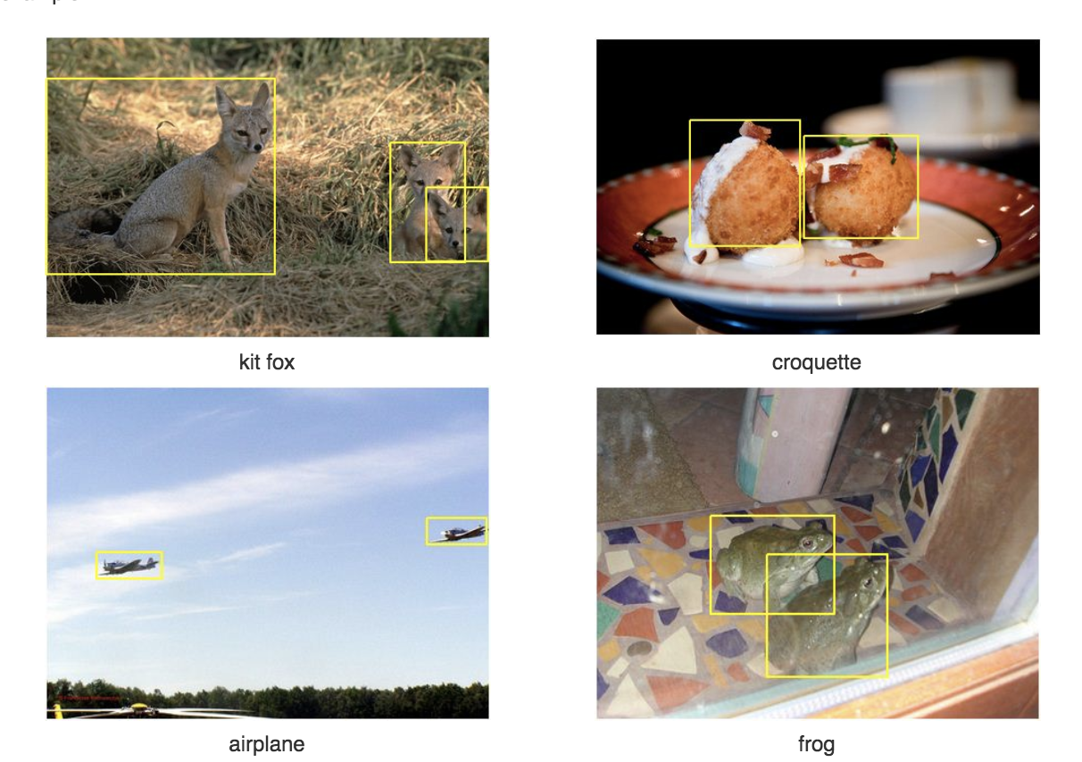

Supervised Learning in Computer Vision
Object localization and detection
$x=$ raw pixels of the image, $y=$ the bounding boxes
ImageNet Large Scale Visual Recognition Challenge. Russakovsky et al.’2015

Slide 23
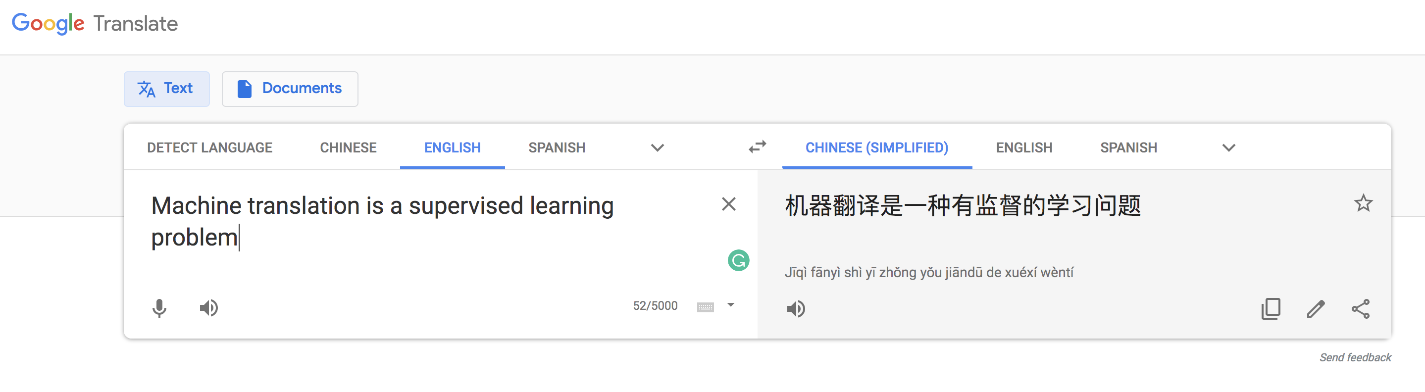


Supervised Learning in Natural Language Processing
Machine translation
$$x$$
$$y$$
Note: this course only covers the basic and fundamental techniques of supervised learning (which are not enough for solving hard vision or NLP problems.)
CS224N and CS231N would be more suitable if you are interested in the particular applications

Slide 24
Unsupervised Learning

Slide 25

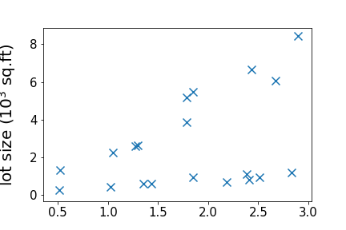

Unsupervised Learning
Dataset contains no labels: $x^{\left(1\right)}, …x^{\left(n\right)}$
Goal (vaguely-posed): to find interesting structures in the data
supervised
unsupervised

Slide 26
Clustering

Slide 27
Clustering
Lecture 12&13: k-mean clustering, mixture of Gaussians

Slide 28
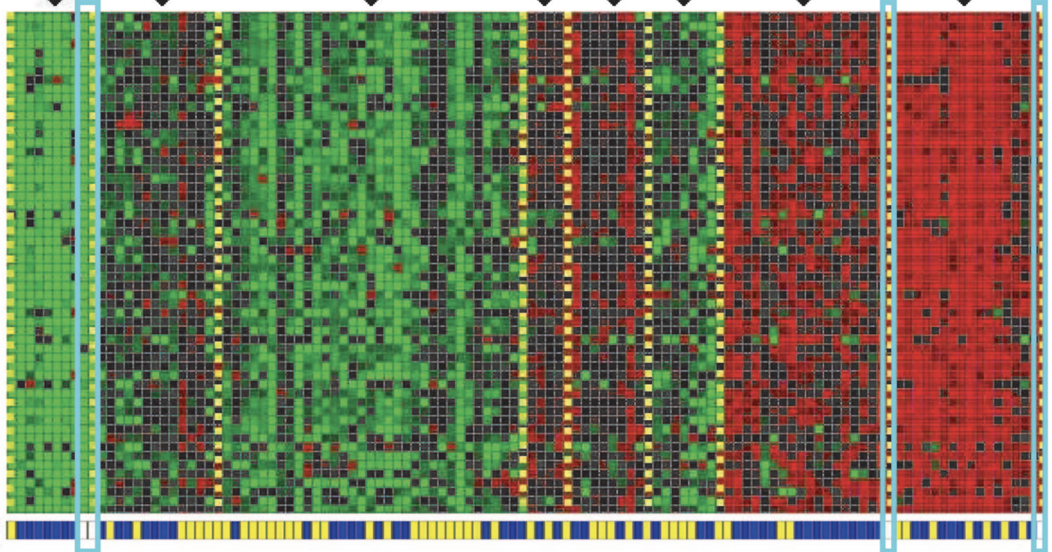
Clustering Genes
Cluster 1
Cluster 7
Genes
Individuals
Identifying Regulatory Mechanisms using Individual Variation Reveals Key Role for Chromatin Modification. [Su-In Lee, Dana Pe'er, Aimee M. Dudley, George M. Church and Daphne Koller. ’06]

Slide 29
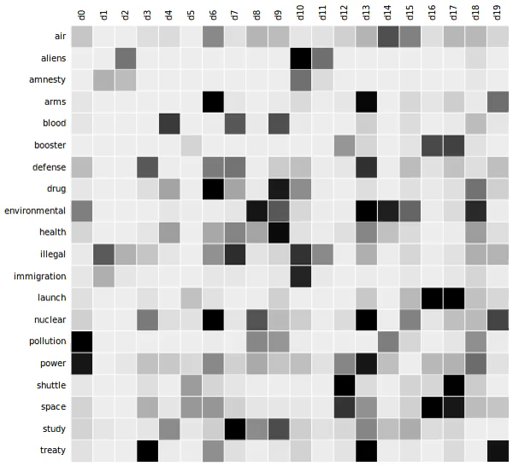
Latent Semantic Analysis (LSA)
documents
words
Lecture 14: principal component analysis (tools used in LSA)
Image credit: https://commons.wikimedia.org/wiki/File:Topic_
detection_in_a_document-word_matrix.gif

Slide 30



Word Embeddings
models
Unlabeled dataset
Represent words by vectors
word
$\underset{→}{encode }$
vector
relation
$\underset{→}{encode }$
direction
Rome
Paris
Italy
Berlin
France
Germany
Word2vec [Mikolov et al’13] GloVe [Pennington et al’14]
Notes:
Define vectors

Slide 31
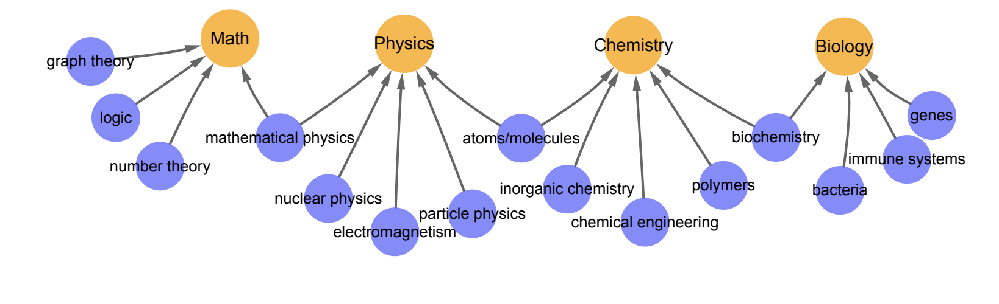
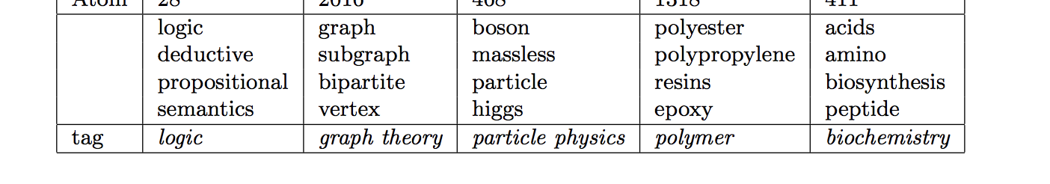
Clustering Words with Similar Meanings (Hierarchically)
[Arora-Ge-Liang-M.-Risteski, TACL’17,18]

Slide 32
Reinforcement Learning

Slide 33
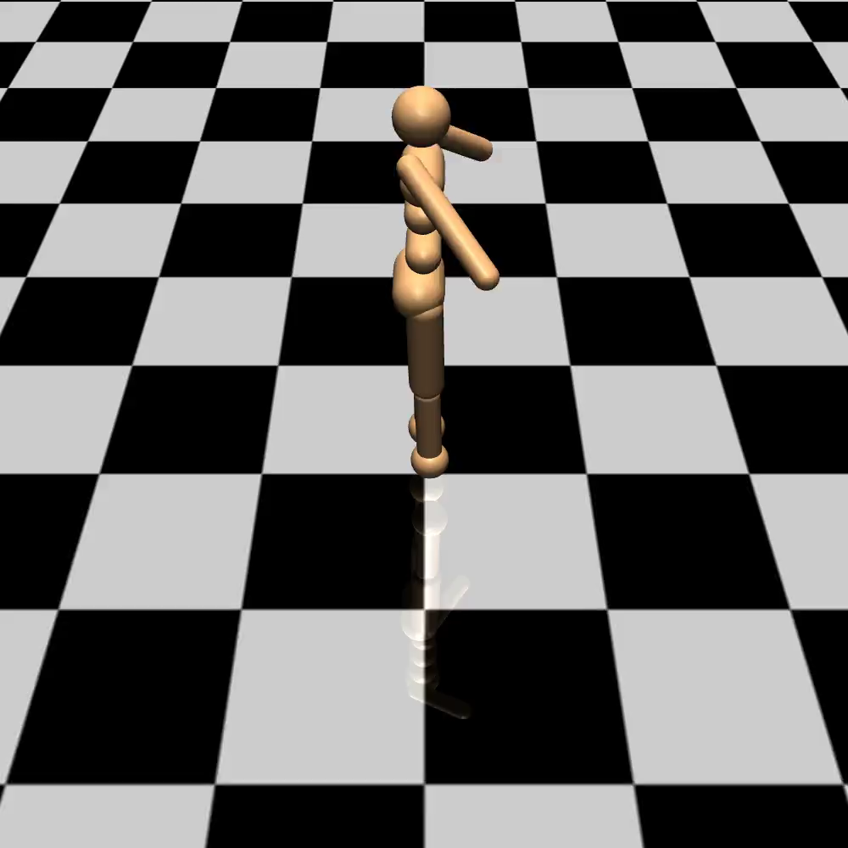
learning to walk to the right
Iteration 10
[Luo-Xu-Li-Tian-Darrell-M.’18]

Slide 34
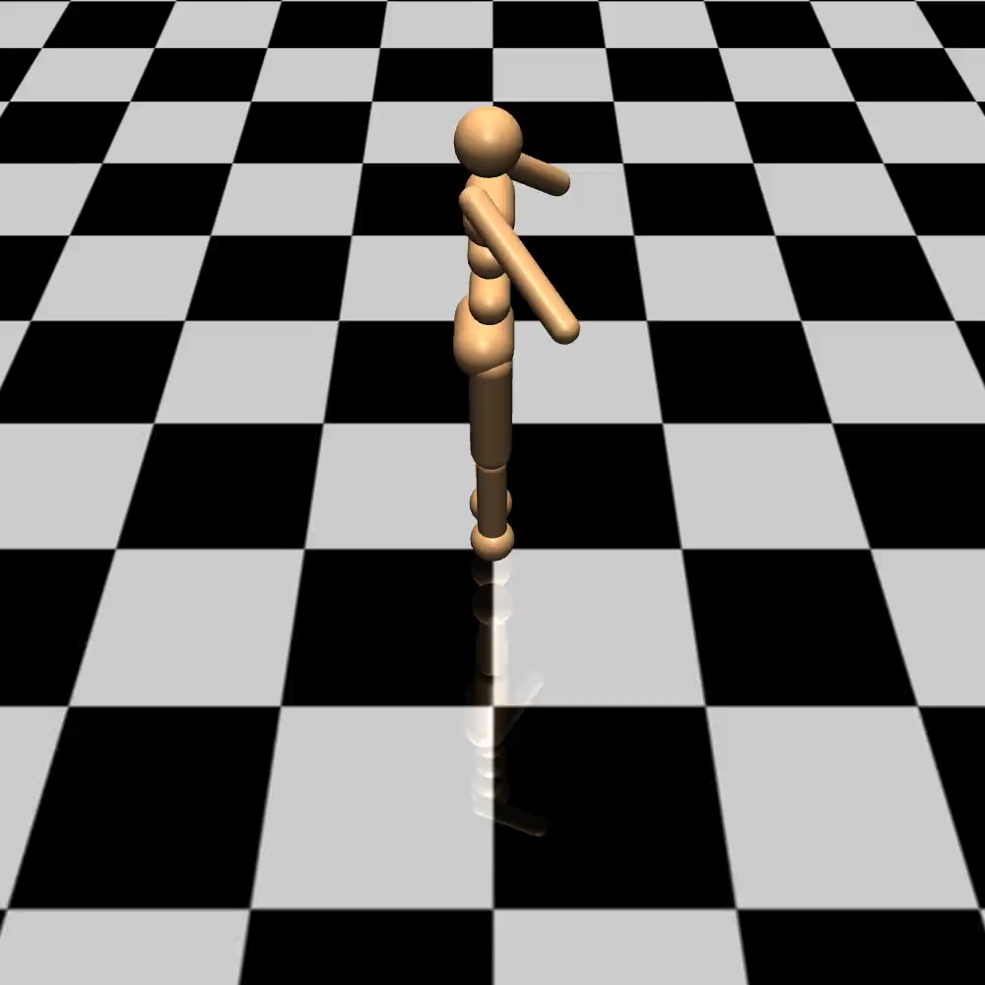
learning to walk to the right
Iteration 20
[Luo-Xu-Li-Tian-Darrell-M.’18]

Slide 35
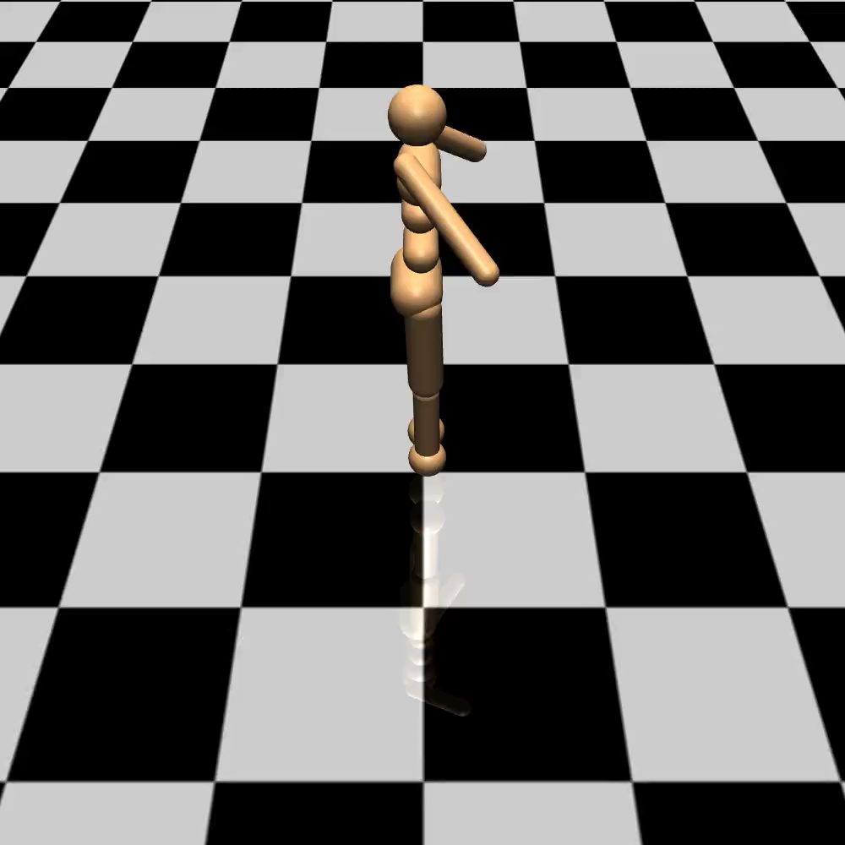
learning to walk to the right
Iteration 80
[Luo-Xu-Li-Tian-Darrell-M.’18]

Slide 36
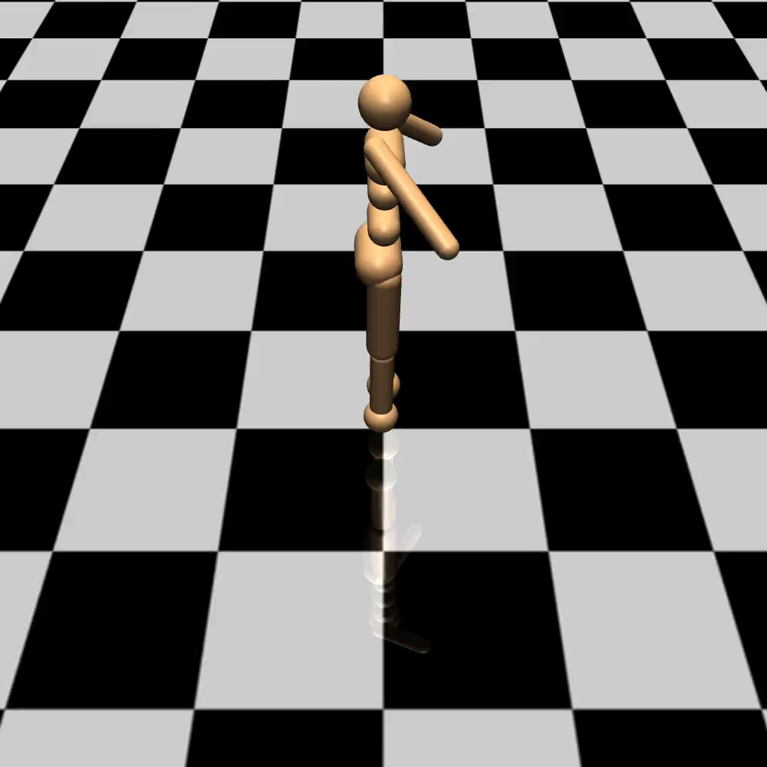
learning to walk to the right
Iteration 210
[Luo-Xu-Li-Tian-Darrell-M.’18]

Slide 37
Reinforcement Learning
The algorithm can collect data interactively
Try the strategy and collect feedbacks
Data collection
Training
Improve the strategy based on the feedbacks

Slide 38
Taxonomy of Machine Learning (A Simplistic View Based on Tasks)
Supervised
Learning
Unsupervised
Learning
Reinforcement
Learning
can also be viewed as tools/methods

Slide 39
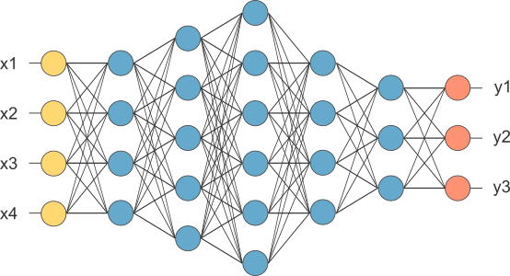
Other Tools/Topics In This Course
Deep learning basics
Introduction to learning theory
Bias variance tradeoff
Feature selection
ML advice
Broader aspects of ML
Robustness/fairness

Slide 40
Questions?
Thank you!

Slide 41
My Group’s Research: Machine Learning Tools/Theory
How do we
train faster?
pick the correct model (and hyperparameters)?
regularize the models so that they can generalize with fewer samples to unseen scenarios?
robustify the models?
Various settings:
supervised learning
unsupervised learning
reinforcement learning

Slide 42

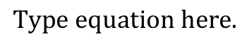

Reinforcement Learning

